Slide 1
H.R. 647: Palliative Care And Hospice Education And Training Act
Student’s Name
HealthCare Policy Assignment
NR451

Slide 2
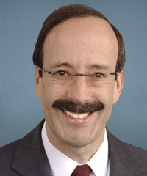
Bill summary
Bill sponsored by Eliot Engel
Introduced in Jan 27, 2019
More palliative care faculties at accredited medical schools
Promote education and research in palliative care and hospice
Support the development of faculty careers in academic palliative medicine.
49% chance of being enacted according to Skopos Lab
Eliot Engel
Notes:
To amend the Public Health Service Act to increase the number of permanent faculty in palliative care at accredited allopathic and osteopathic medical schools, nursing schools, social work schools, and other programs, including physician assistant education programs, to promote education and research in palliative care and hospice, and to support the development of faculty careers in academic palliative medicine.
This bill is in the first stage of the legislative process. It was introduced into Congress on January 17, 2019. It will typically be considered by committee next before it is possibly sent on to the House or Senate as a whole.
The bill is sponsored by Eliot Engel a representative for New York's 16th congressional district. Democrat.

Slide 3
Bill Impact on Professional Nursing Practice Standards
Nurses in palliative care and hospice deal with unique needs of patients.
The patients and families are often facing serious illness at the end of life.
shortage of adequately trained hospice or palliative care providers.
In the next 20 years, the number of people eligible for palliative care will increase by over 20 percent.
Bill will reduce the nursing workload by establishing Education Centers for Palliative Care and Hospice.
Notes:
Hospice is a person-centered model that works to meet the unique needs of patients and families facing serious illness at the end of life. Education and training programs can stem provider shortage issues by encouraging more individuals to pursue a profession in the hospice and palliative care fields. There is a shortage of adequately trained hospice or palliative care providers, and the current rates of educating and training medical professionals in palliative care will not be sufficient to ensure aging Americans access to quality palliative care. Estimates show that there will be no more than 1 percent growth in the palliative care and hospice physician workforce in the next 20 years, while the number of people eligible for palliative care will increase by over 20 percent. Without a boost for palliative care education and training, there will be only one palliative physician for every 26,000 seriously ill patients by 2030.

Slide 4
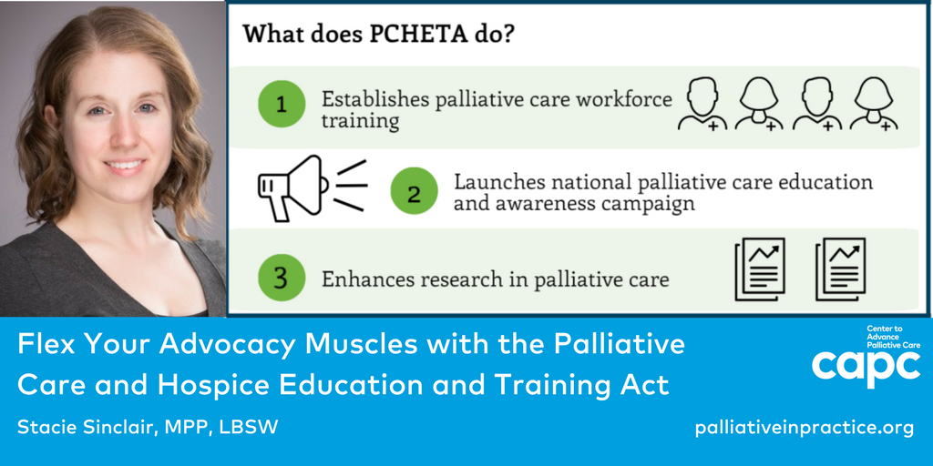
Bill impact on my own nursing practice
With the bill being passed, funds will be available to advance my education in palliative care.
Clinical training in interprofessional team-based palliative care
The training will improve my nursing practice
Notes:
Training on Palliative care will improve my nursing practice by:
Providing patient-centered and family-centered support throughout the continuum of care for serious and life-threatening illness.
Anticipating, preventing, and treating physical, emotional, social, and spiritual suffering.
Facilitate and support the goals and values of patients and families.
Help optimize quality of life.

Slide 5

Communication about the Bill
Having any concern about the bill, I will write to Eliot Engel to alert him of my worries
I may also look for his contacts and look for his close associates to deliver my concerns
In supporting the bill, I would contact the congress representatives to support the bill

Slide 6
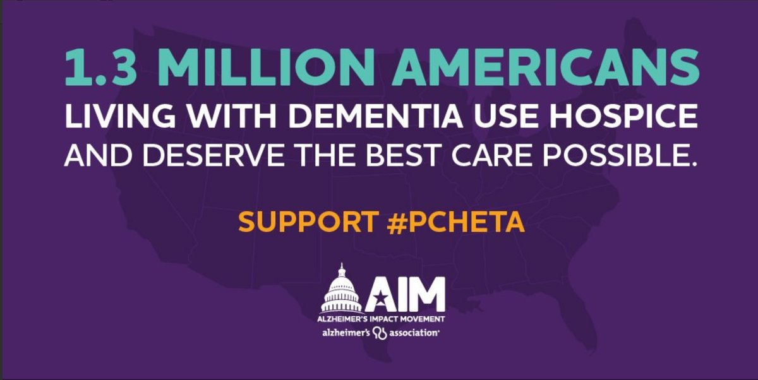
Bill Impact on the Community
The bill seeks to establish a National Awareness Campaign
Palliative care specialists reduce the risk the risk of dying in hospital by half
Presence of palliative care specialist reduce the risk of the need for emergency care in the last two weeks of life by a quarter.
Notes:
The National Awareness Campaign will inform the public and healthcare professionals about this important field of practice and ensure it is equipped to serve the increasing need of patients.
Having palliative care specialist team compared with usual care significantly reduces the risk of being in hospital and going to an emergency department in the last two weeks of life by a third and a quarter respectively, and reduces the risk of dying in hospital by half.
It also significantly reduces the use of acute care services in late life and allows patients to die outside of hospital.

Slide 7
References
American Nurses Association. (2015). Nursing: Scope and standards of practice (3rd ed.). Silver
H.R. 647 — 116th Congress: Palliative Care and Hospice Education and Training Act.” www.GovTrack.us. 2019. March 7, 2019 https://www.govtrack.us/congress/bills/116/hr647

